Slide 1
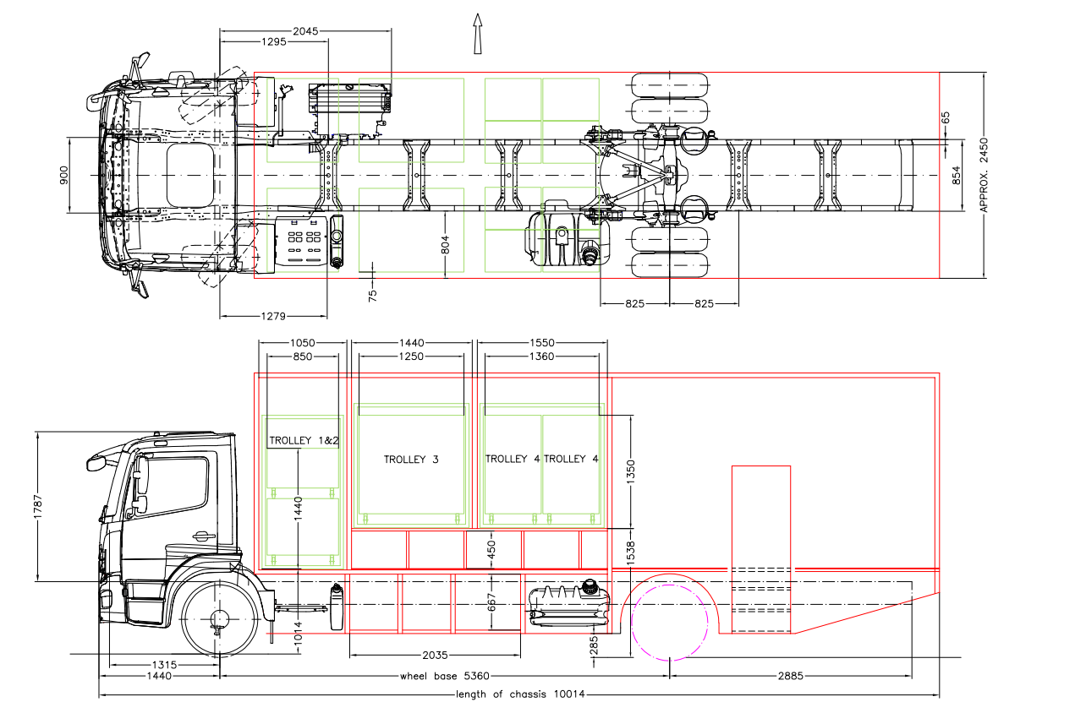
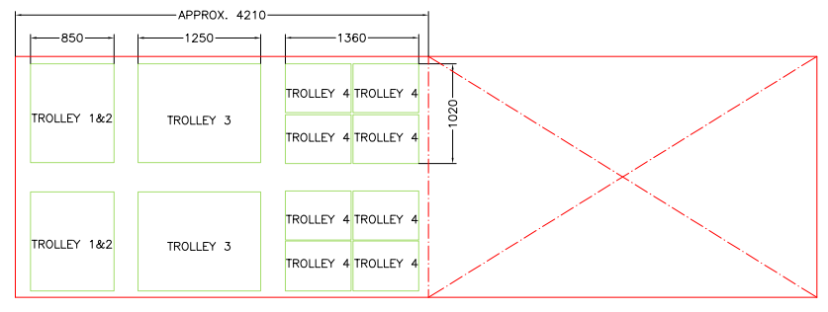
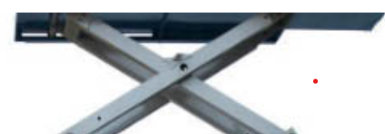
Proposal location for the scissor lift
Proposal location for the scissor lift with compartment size 2035 x 804 x 667mm

Slide 2
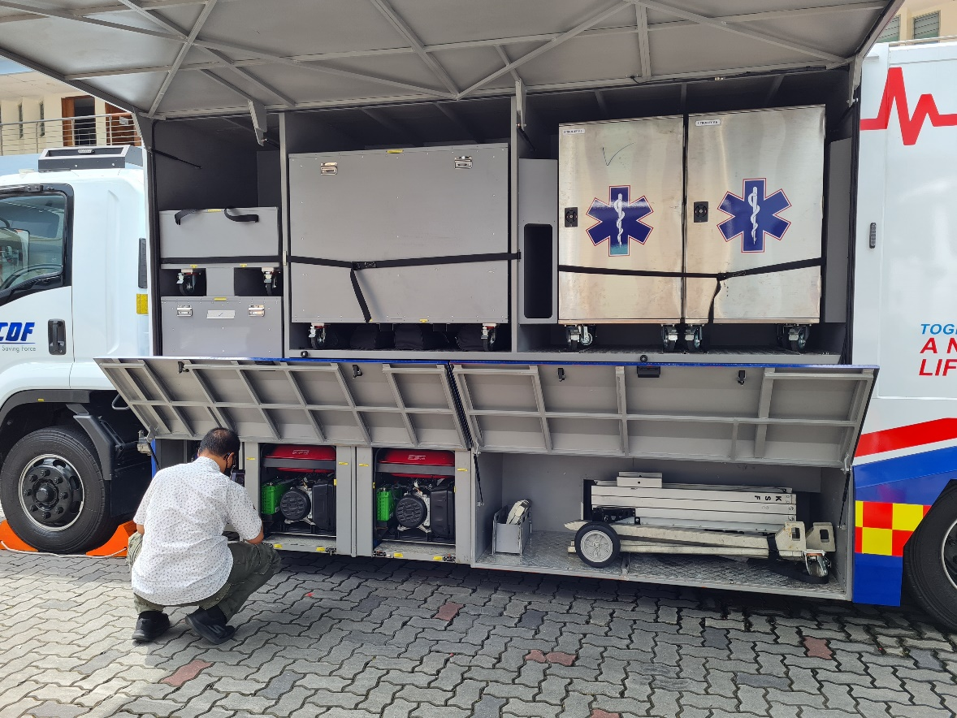
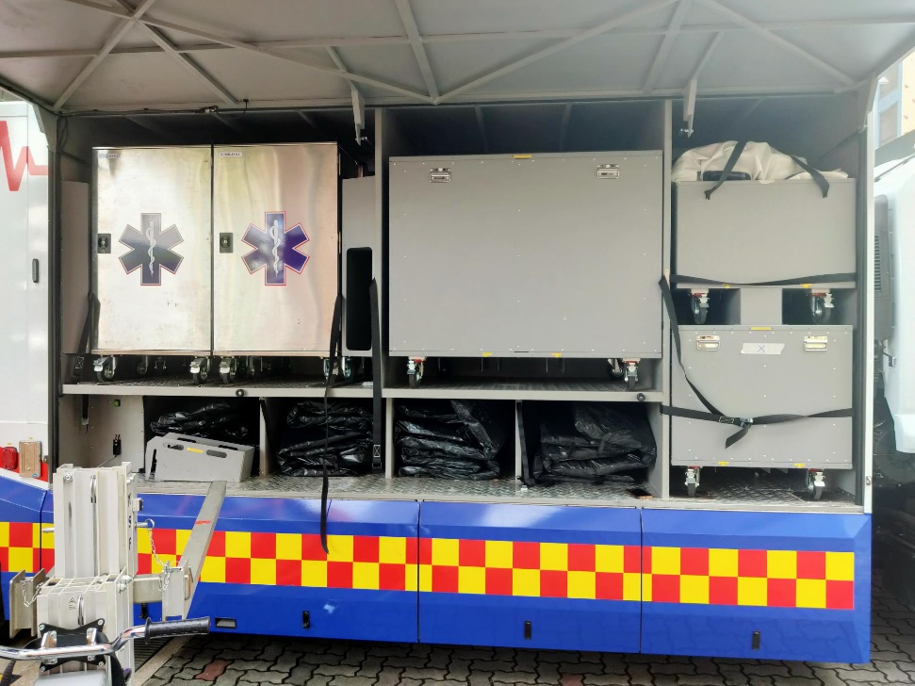
Proposal location for the scissor lift ( Left and right of chassis)

